Slide 1
A TRIP AROUND THE HIPS
References:
Anatomy of Exercise & Movement
Concise Book of Yoga Anatomy
by Jo Ann Staugaard-Jones WWW.MOVE-LIVE.COM
HIP FLEXORS
HIP ABDUCTORS
HIP EXTENSORS
Hip adductors
Rotators
ASANAS
STRETCHES

Slide 2
HIP FLEXORS (anterior) Hip flexion is the action of bringing the thigh forward.
3 main flexors on front of thigh (shown in next 3 slides):
Rectus Femoris
Sartorius
Iliopsoas muscle group
2 assisting flexors: (slightly anterior)
Tensor Fascia Lata
Pectineus
(ASANAS are listed on the next slides under the 3 main muscle diagrams)

Slide 3
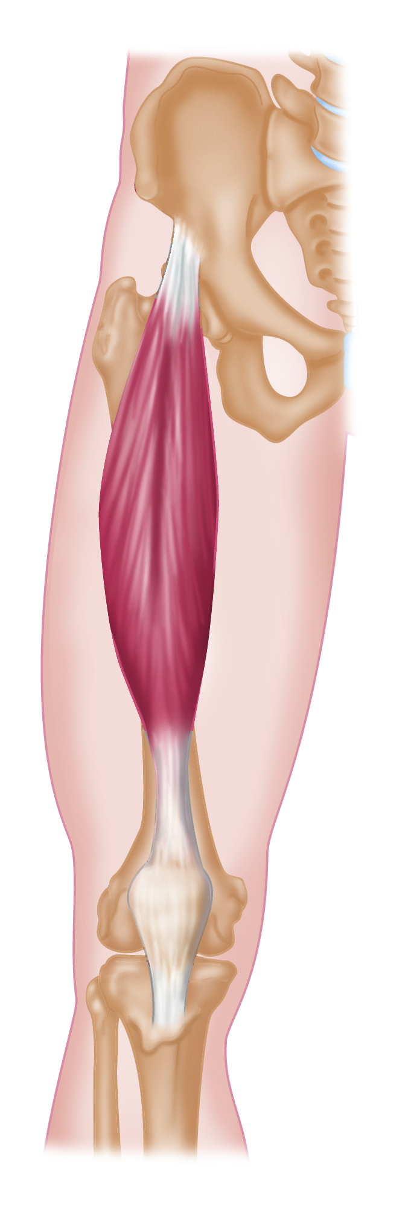
RECTUS FEMORIS – A SUPERFICIAL (NEAR THE SURFACE) HIP FLEXOR
ALSO 1 OF 4 QUADRICEPS MUSCLES MAKES IT A BIARTICULAR MUSCLE (WORKING 2 JOINTS, THE HIP & KNEE)
ASANAS:
Strengthening:
The front leg in Anjaneyasana (Crescent),
Lunges, Virabhadrasanas (Warriors) I, II, III.
Both legs in Navasana (Boat);
and most 1-leg standing postures (see slide # 5).
Stretching:
Setu Bhandasana (Bridge), Dhanurasana (Bow).
Back leg in Anjaneyasana, Virabhadrasanas I, II, III, Natarajasana (Dancer), & Lunge.
Both legs in backbending.

Slide 4
THE SARTORIUS: HIP FLEXOR AND THE LONGEST MUSCLE IN THE BODY
IT NOT ONLY CAN PERFORM HIP FLEXION, BUT ALSO HIP OUTWARD ROTATION.
IT IS A BIARTICULATE MUSCLE AS IT ATTACHES PAST THE KNEE JOINT AND CAN ASSIST KNEE FLEXION
ASANAS:
Strengthening:
See “Rectus Femoris” and slide #5.
Also Sukhasana (Easy Pose), Padmasana (Lotus), both sitting positions Stretching:
Any stretch listed under Rectus Femoris;
also Supta Virasana (Reclined Hero Pose).

Slide 5
The Psoas Major, Minor, & Iliacus = THE ILIOPSOAS MUSCLE GROUP Iliacus (on your right) is the strongest, deepest hip flexor Psoas Major ( left) is the connector (lumbar spine to leg), referred to as the “PSOAS” ASANAS: listed under Rectus Femoris and Sartorius, see slides #6 & 7 also.
Notes:
The Psoas Major and Minor are both weak movers, the Iliacus is the stronger hip flexor. The Psoas Major is a more important stabilizer, and biarticulate.
The Psoas Minor was used more when we had 4 legs!

Slide 6
Asana showing all 3 main Hip Flexors: Padangustasana Variation (Extended Hand to Big Toe Balance to side)
All hip muscles are working as stabilizers in the supporting leg.
t
The hip flexors are strengthening in the top leg, whether the leg is in front of the body or to the side.
Letting go of the toe and keeping the leg in the air with the spine straight is most challenging!
For Level I: Supta (reclined) version.

Slide 7
Anjanyasana (Crescent)
Notice:
the stretch of the Psoas
in the back leg
the stabilization at the spine
and in the front leg the iliopsoas
in isometric contraction

Slide 8
HIP ABDUCTORS (lateral) Hip Abduction is the action of bringing the leg out to the side.
TENSOR FASCIA LATA (part of ITB)
GLUTEUS MEDIUS
GLUTEUS MINIMUS
Considered lateral, on the outside of the thigh.
When concentrically contracting, lifts leg to the side against gravity.
ASANAS: Strengthening: Parighasana (Gate Pose), Prasarita Padottanasana (Wide-leg Forward Bend), back leg of Warrior II and Trikonasana (Triangle),
& most standing postures as the abductors stabilize.
Stretching: Supine Twist with both knees bent,
or 1 leg straight and the other bent.

Slide 9
Parighasana (Crossbar or Gate Pose)
The Gluteus Minimus is hidden by the Gluteus Maximus, which is pictured because it is part of the Ilio-Tibial Tract, known as the ITBand.
The straight leg is in an abducted position; imagine more strength work for the abductors when the torso bends to the opposite side
and one can lift the leg.
In the bent, supporting leg the abductors and adductors are stabilizing, and the
abductors stretch slightly.
Gate Pose is often done with the straight leg in outward rotation: yogi’s choice!

Slide 10
HIP EXTENSORS (posterior) Hip extension is the action of bringing the thigh back.
Gluteus Maximus
3 Hamstrings:
Biceps Femoris
Semitendinosis
Semimembranosis
All located on the back of the hip/thigh, they can also do other actions at the hip joint.
The hamstrings also work the knee joint, therefore they are _________________ !

Slide 11
ASANAS for Hip Extension
Strengthening:
Utkatasana (Chair),
Ustrasana (Camel),
Salabhasana ((Locust),
Dhanurasana (Bow),
Setu Bandhasana (Bridge),
back leg of Warrior III & Natarajasana (Dancer)
Stretching:
Balasana (Child’s Pose), Halasana (Plow),
All Forward Bends.
(Hamstrings will stretch more when the knee is straight.)

Slide 12
Dhanurasana (Bow Pose)
A classic backbend, this posture also presents hip extension.
To get into the pose, one lies on the belly and reaches back for the feet.
As the legs are lifted, both the Gluteus Maximus and Hamstrings concentrically contract (shorten) to strengthen.
The Hamstrings are further involved because the knees bend.
Once in the posture, try releasing the ‘grip’ those muscles.

Slide 13
HIP ADDUCTORS (medial) Hip adduction is the action of bringing the legs together.
There are 5, in descending order:
PECTINEUS
3 ADDUCTORS: Brevis, Longus, Magnus
GRACILIS
Located on the inside of the leg,
they ‘shape’ the inner thigh

Slide 14
ASANAS
Strengthening:
Parsvottanasana (Pyramid, next slide),
Parivrtta Trikonasana (Revolved Triangle),
most standing postures using adductors as stabilizers.
Stretching:
Baddha Konasana
(Bound Angle),
Happy Baby to
Supta Konasana
(Reclined Straddle),
Prasarita Padottanasana (Straddle Forward Bend),
Upavista Konasana (Sitting Wide-leg Straddle)

Slide 15
PARSVOTTANASANA (Pyramid Pose)
This posture activates the adductors of both legs, as they engage to stabilize the balance by keeping the legs underneath and aligned
as one bends forward.
The adductors are pictured on the inside of the front leg; the back leg shows the muscles that are stretching.
A nice progression from here is Revolved Triangle, where the adductors are still working strongly.
Use of blocks is helpful.

Slide 16
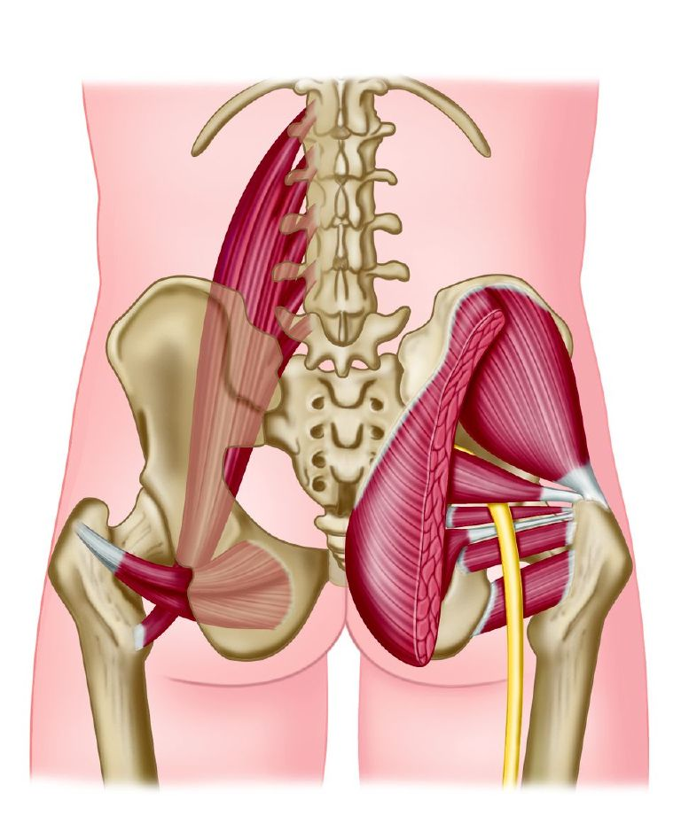
The 6 DEEP ROTATORS Outward rotation is when the femur rotates laterally, or to the outside. The 6 rotators on right in descending order: Piriformis, Gemellus Superior, Obturator Internis, Gemellus Inferior, Obturator Externus (shown on left), and Quadratus Femoris (not related to Rectus Femoris or quads!). (Notice the Psoas Major on your left, not one of the 6 deep rotators)

Slide 17
THE PIRIFORMIS
One of the 6 ROTATORS, the Piriformis
affects the sciatic nerve as it passes over it.
Named a culprit in ‘sciatica’ when the muscle is tight,
it is the horizontal muscle that passes
above the sciatic nerve.
Also notice the SI joints on either side of the sacrum,
the Psoas Major on the left
and Gluts on the right.
One can see the stability of this whole area
can be easily compromised.

Slide 18
ARDHA CHANDRASANA (Half Moon)
In this pose both the top and bottom leg are outwardly rotating at the hip,
as well as flexing.
Other Asanas that STRENGTHEN
the deep rotators:
Goddess,
Warrior II and Triangle (front leg), Padmasana (Lotus),
Baddha Konasana, (Bound Angle),
Vrksasana (Tree, top leg),
Janu Sirsasana (bent leg).
STRETCHING:
Pigeon (front leg),
Gomukhasana (Cow legs),
Supta Virasana (Reclined Hero Pose), Crossed Leg Stretch

Slide 19
EKA PADA RAJAKAPOTASANA (Pigeon)
One can see the slight outward rotation of the front leg here,
but the pressure of body weight and positioning of the leg will also stretch the deep outward rotators
as the thigh works towards the midline in adduction.

Slide 20
CONDITIONS/injuries
Tightness
Overuse
Underuse
Muscle Strains
Ligament Sprains
Arthritis
Bursitis
Labrum Tear
Dislocation
Hip Replacement

